Slide 1
L4/L5 Group 3
Elliot Chester
Matthew Fisher
Lenneth Dayaon
Adam Speers

Slide 2
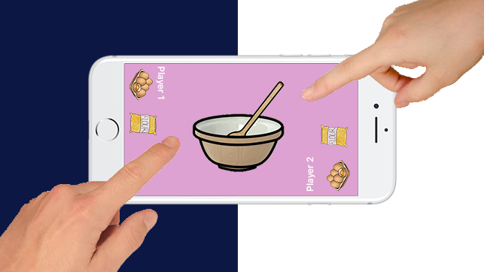
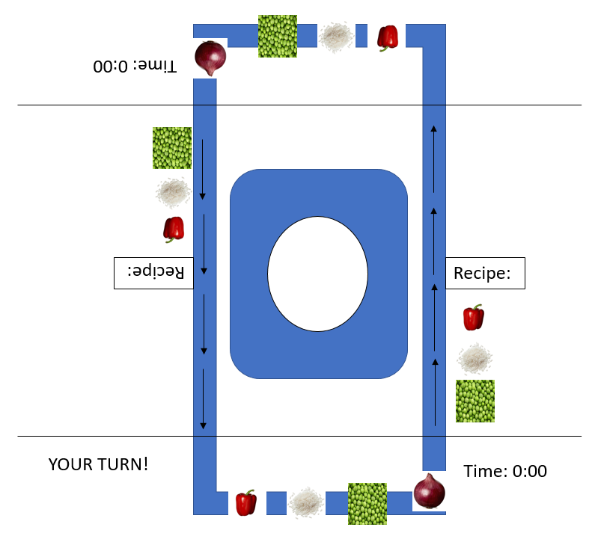
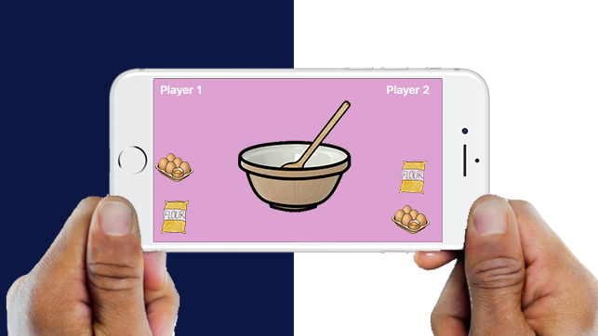
Our Ideas
We had many ideas that we have narrowed down to these
2D Cooking Game
Turn-based Adversary Multiplayer
Tap to pick ingredient
Select ingredients and follow the recipe
Players to will scored on completion time and difficulty of recipe
Symmetric Gameplay
Notes:
Matthew
We’ve gone through many ideas for our game, we’ve managed to refine it down to 2 final ideas which are similar but feel very different to play.
Both ideas are 2D cooking games, each player will take turns looking at a recipe and remembering which ingredients are needed.
Players will be scored on how much they manage to remember and how long it took them to make their food.
The game will be symmetric so that each player gets an even playing field

Slide 3
Idea 1
Ingredients are on a moving conveyer belt
Players must remember their required ingredients
Players take turns picking ingredients
More score for speed
Recipes will have different ingredients and completion times.
If time runs out you fail
Notes:
Elliot
This idea is focused more on twitch mechanics over memory.
It has the ingredients moving around on a conveyer belt, the player has to remember what ingredients they need, then click them before they leave their side of the screen.
This has the potential to have different difficulty settings that will change the speed of the conveyer belt to make it harder to tap the item you want.
The players will be timed, the faster they complete their recipe the more points they will get. If you run our of time you fail or recipe and the other player will win.

Slide 4
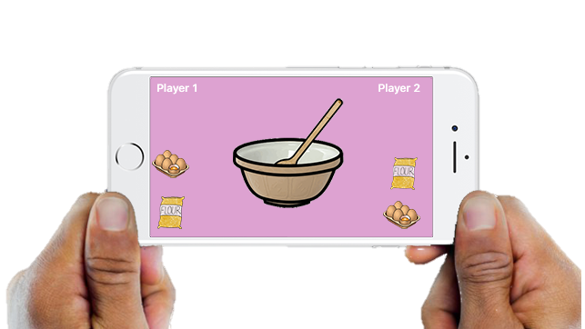
Idea 2
Ingredients are shown on each side of the screen
Players must select their required ingredients
Players take turns picking ingredients
More score for speed
Recipes will have different ingredients and completion times.
If time runs out you fail
Simpler and less confusing that Idea 1
Notes:
Elliot
This game focuses more on having the player remember things, they will be shown a recipe card for a couple of seconds. The amount of ingredients on the recipe card will depend on the difficulty they have chosen.
Each player will then take their turn remembering and selecting the ingredients needed for their recipe. Players will be scored on how many of the ingredients they get right.
This idea is a lot more casual than the other one because the player can take their time and doesn’t have to click things quickly to get a better score.

Slide 5


Target Audience
Mobile Casual Gamers
Gender: Female
Age: 21-35
60-70% of the current market
21-35
Notes:
Lenneth
After doing some research we have decided to set our target audience as casual gamers.
We will target our game towards women aged 21 – 35 years old, we’ve chosen these people because they are 60 – 70% of the current market within the style of game we have chosen.

Slide 6
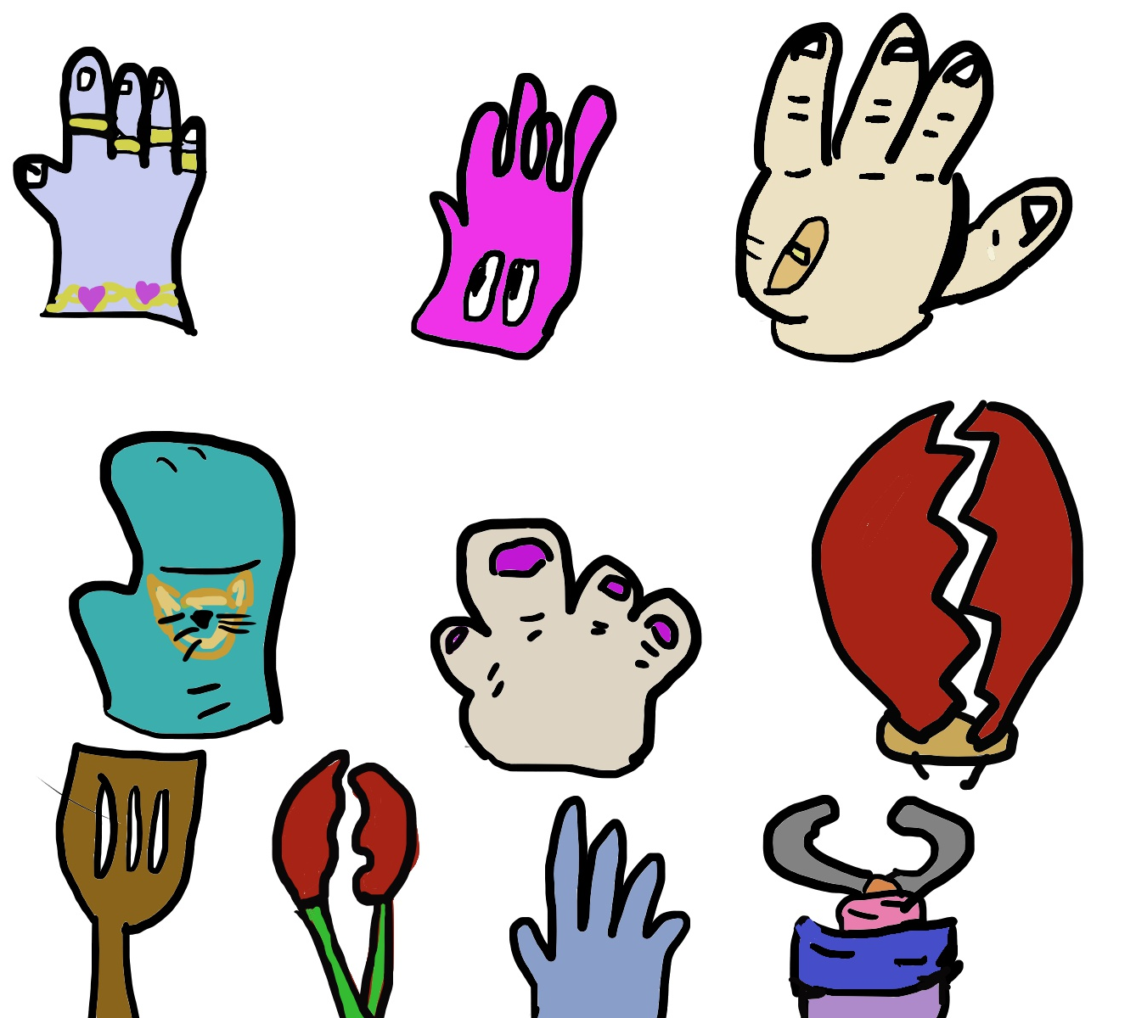
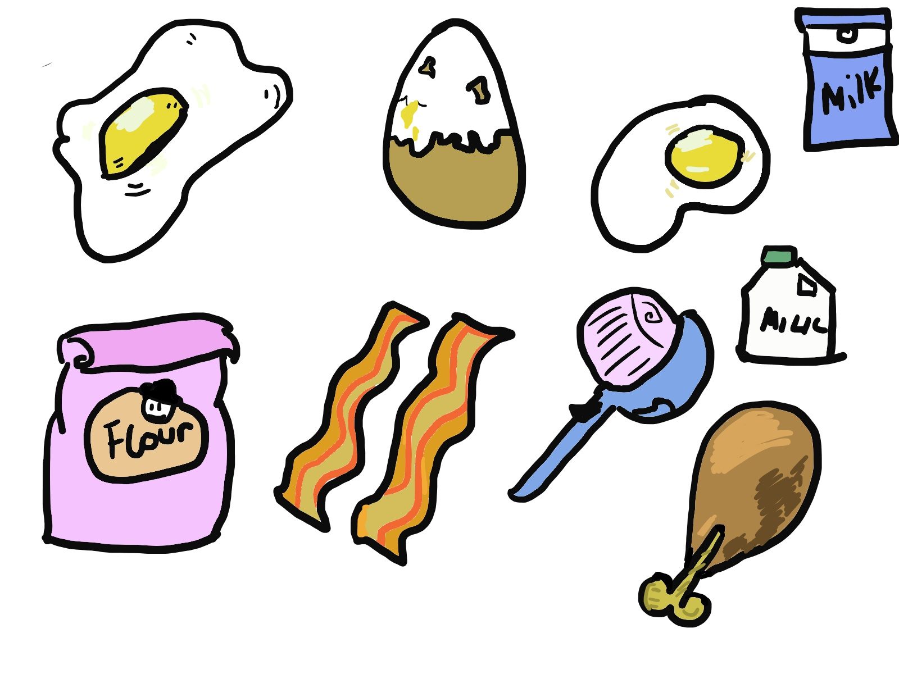
Art Style
Cartoon Style
Cell Shaded Graphics
Notes:
Lenneth
For our art style we have chosen to go with cartoony cell shaded graphics, this is because this is what connects with our target audience best and keeps each item easy to recognise at a glance.

Slide 7
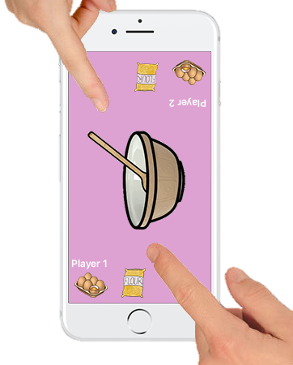
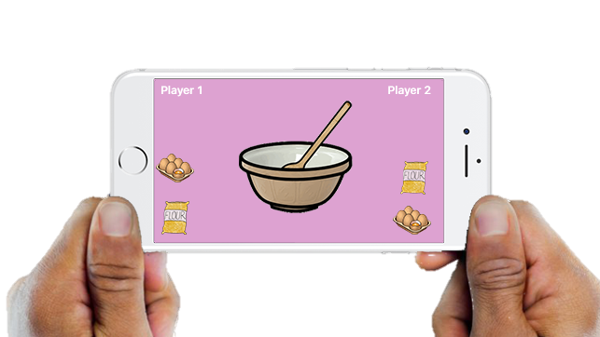
Optimising for Mobile
Use Icons rather than text
Buttons must not be too small
Screen orientation must be best for 2 players
Notes:
Adam
Mobile and desktop have very different sized screens, there are some things we have to do to optimise our game for mobile and our casual style of game.
We should use icons rather than text where possible, this makes it easier for the player to know what they have to tap on and what they have to read.
Buttons that may seem like an acceptable size on a desktop or laptop, may look tiny on a mobile screen so we have to make sure that all of the buttons are the correct size for the screen we will be using.
Our game will be multiplayer, which means we have to think about how things are laid out on the screen. Portrait orientation with each player facing the screen. Landscape orientation with player sitting next to each other. We will have to experiment with these 2 layouts and create prototypes to see which is best for our game.

Slide 8
Any Questions?

